Slide 1
OnChip Team
Team members:
Alex Mantilla <alex-mantilla> (M-I)
Sebastián Suárez (B)
Jose Algarin (B)
Ramón Sarmiento (B)
Julián Romero (B)
Fabián Chacón (B)
Jorge Angarita (M)
Ricardo Vergel (M-I)
Luisa Dovale (M-I)
*And some occasional contributor
Team background
Academic Experience:
M: MSc Student at UIS
B: BSc Student at UIS
Work Experience
I: Experience on industry
Video presentation:
https://youtu.be/Y6UKVFCD-yw

Slide 2
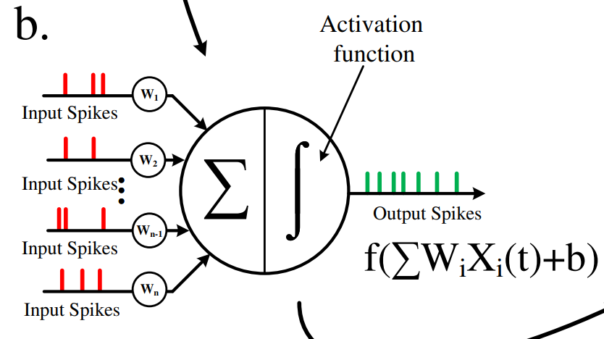
OnChip Team
Project Title: Ring Oscillator-Based Spiking Neuron in MOSbius
Our goal is to implement a neuron circuit, the basic building block of a more complex neural network.
In the MOSBius context, we envision modularity through the implementation of scalable digital gates and comparator strength definition.
Image taken from M. Besrour et al., "Analog Spiking Neuron in 28 nm CMOS"

Slide 3
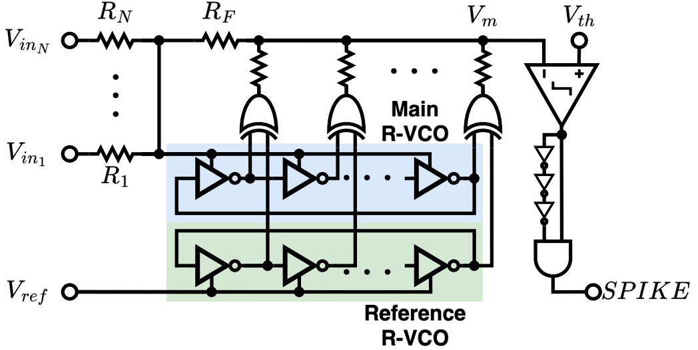
OnChip Team
The chosen architecture uses a RO-based low pass filter for a LIF* neuron implementation.
Image taken from S. Sanjeet, et al, "Systematic Design of Ring VCO-Based SNN - Translating Training Parameters to Circuits”
*Leaky Integrate and Fire

Slide 4
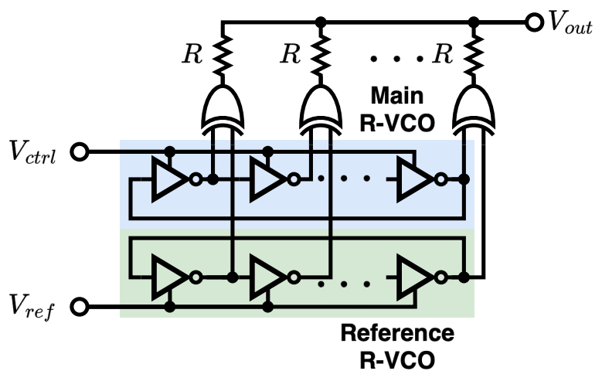
OnChip Team
Design approach: The LPF requires an integrator composed of a pair of ring oscillator voltage-controlled oscillators (VCOs) and XOR-based phase detectors. These will be separated into different MOSbius modules.
Image taken from S. Sanjeet, et al, "Systematic Design of Ring VCO-Based SNN - Translating Training Parameters to Circuits”

Slide 5
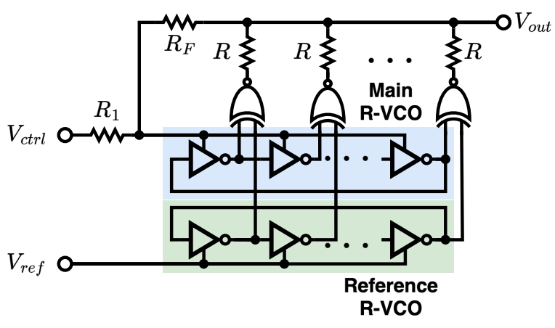
OnChip Team
Design approach: A low-pass filter can be implemented by incorporating external feedback resistors. The neuron will be completed after adding the comparator and edge detector, which are two additional MOSbius modules.
Image taken from S. Sanjeet, et al, "Systematic Design of Ring VCO-Based SNN - Translating Training Parameters to Circuits”
Notes:
For example, we can select and connect INV, INVX2, or INVX4 gates according to the ring oscillator requirements. The same applies to NAND and XOR gates. Additionally, the comparator strength can be adjusted through the use of final inverter stages and the gm input stage

Slide 6
OnChip Team
Application:
Future continuations of this work would seek a complete integration for a open source spiking neural networks (SNNs) accelerator.
Within the current scope, this project employs a MOSbius-based implementation to illustrate to EE students how complex systems can be built using fundamental circuits, such as VCOs, comparators, and phase detectors.
References:
[1] S. Sanjeet, S. Das, S. -H. W. Chiang, M. Fujita and B. D. Sahoo, "Systematic Design of Ring VCO-Based SNN - Translating Training Parameters to Circuits," 2024 IEEE 67th International Midwest Symposium on Circuits and Systems (MWSCAS).
[2] M. Besrour et al., "Analog Spiking Neuron in 28 nm CMOS," 2022 20th IEEE Interregional NEWCAS Conference (NEWCAS), Quebec City, QC, Canada, 2022, pp. 148-152, doi: 10.1109/NEWCAS52662.2022.9842088.

